Slide 1
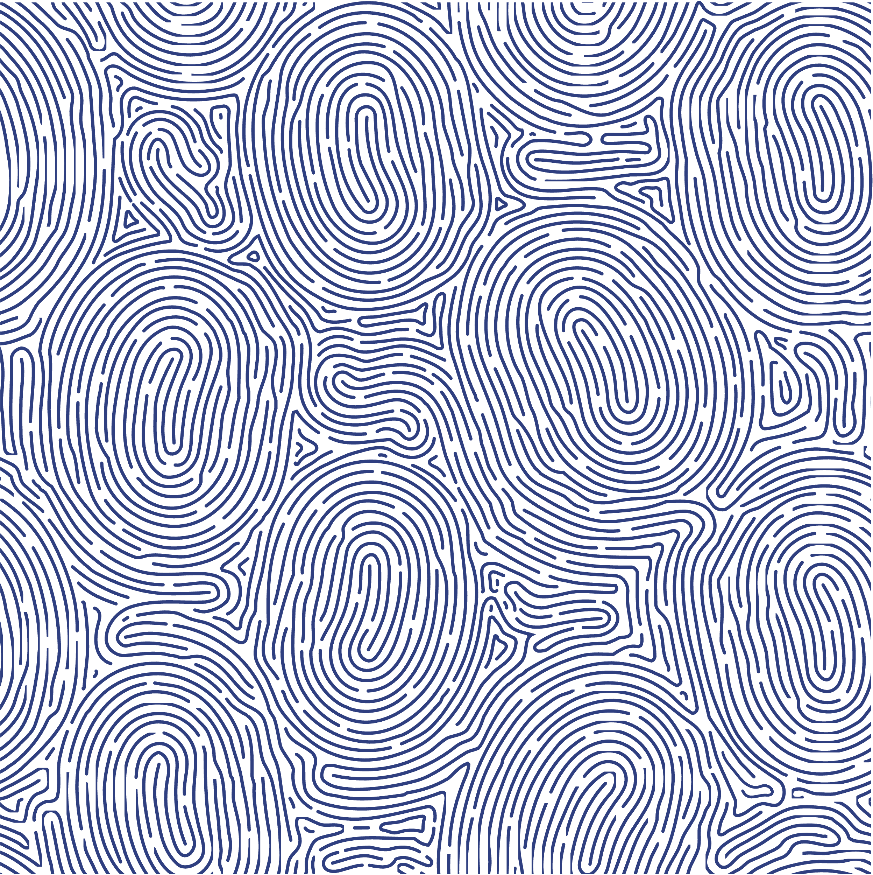
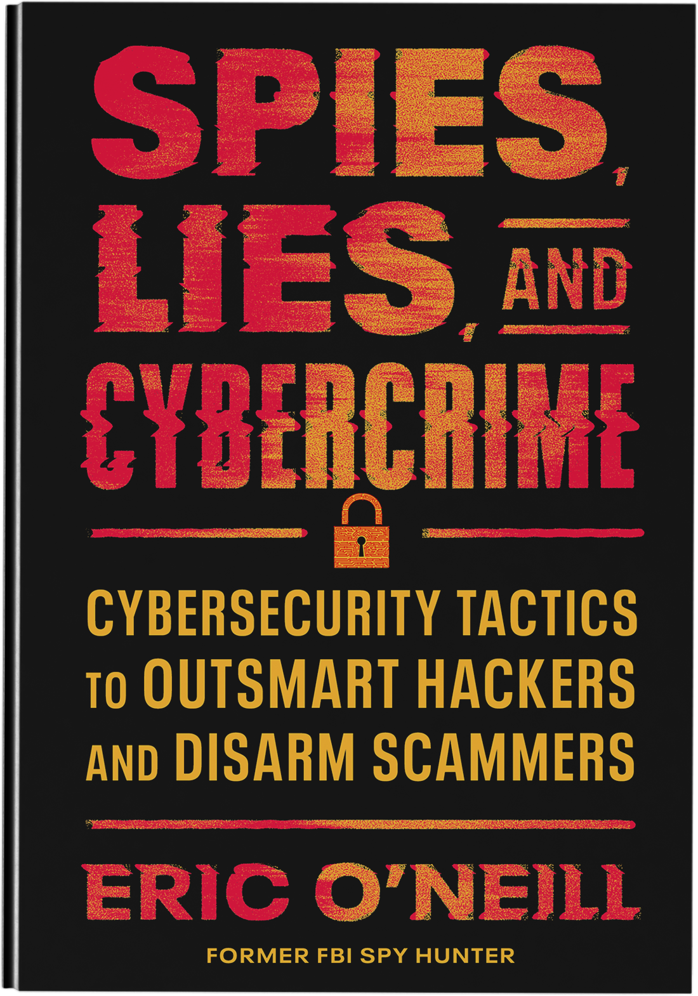
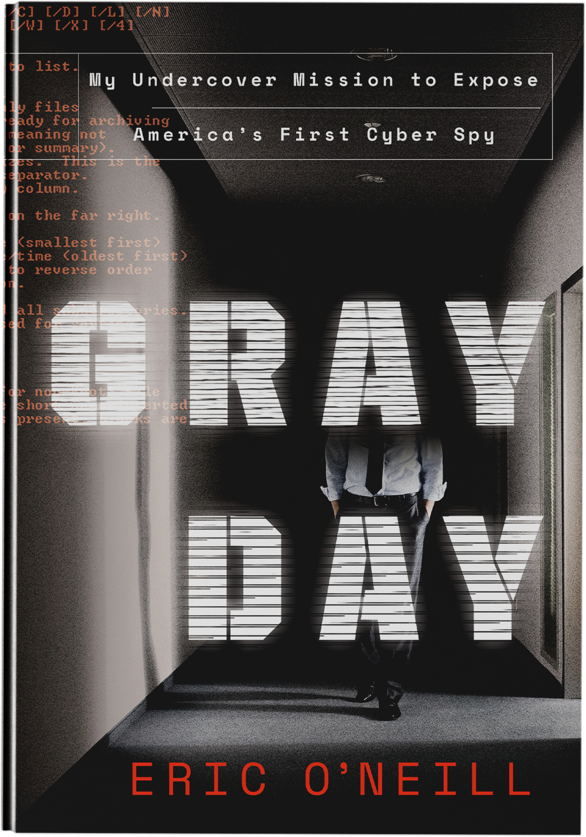
Former FBI Ghost
Founding Partner, The Georgetown Group
National Security Strategist, NeXasure
Author of Spies, Lies, and Cybercrime and Gray Day
Secrets from a Legendary Spy Hunter
Decoding AI Deepfakes, Extortion & More
ericoneill.net

Slide 3
Prepare
Assess
P.A.I.D
Investigate
Decide

Slide 4
Connect with Eric
WWW.EricONeill.NET/Newsletter

