Slide 1
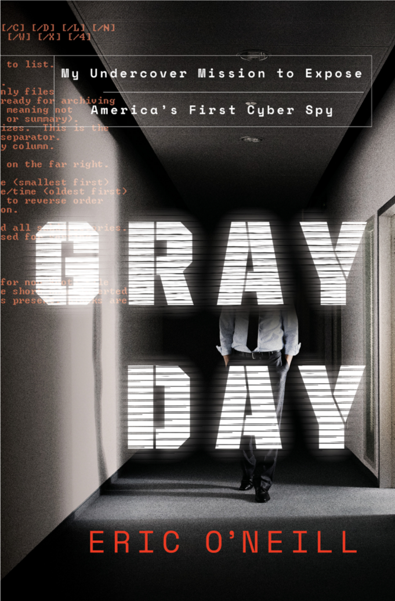
Eric O’Neill
Former FBI Ghost
Founding Partner, The Georgetown Group
National Security Strategist, NeXasure
Author of GRAY DAY:
My Undercover Mission to Expose America’s First Cyber Spy
www.EricONeill.net

